Slide 1
CSE 1207
Input Output Devices

Slide 2
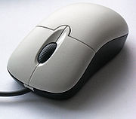
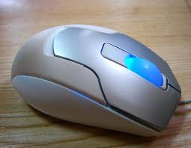
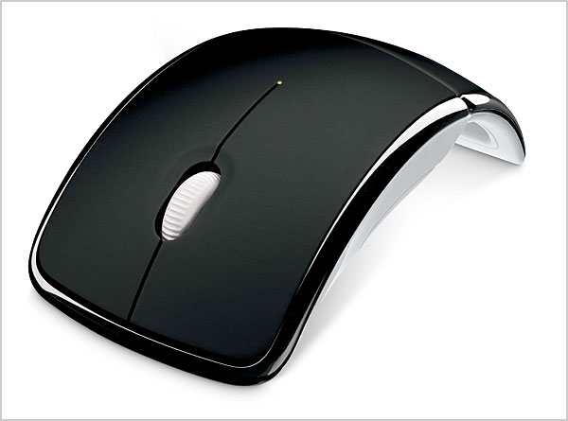
Input
Input devices are used to input data from the external environment into inside the computer
The following are some of the input devices:
  Mouse: a device that is able to control the movement of the pointer on the computer’s screen.

Slide 3

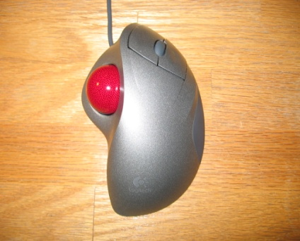
Continue…
Keyboard: set of keys that enable you to enter data into computer
Tracker Ball: an input device in which data is input by moving the ball with finger and causing a corresponding movement on the computer’s screen

Slide 4
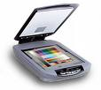

Continue…
Scanner: A device that optically scans an image, printed text, handwritten text and converts it into a digital file
Touchpad: a pointing device whose specialized surface is able to translate the user’s finger motion and action into a corresponding motion or action on the screen. Touchpad is a feature of laptop computers

Slide 5
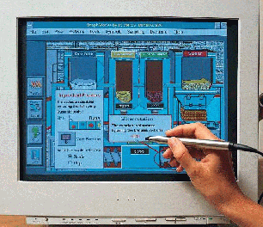
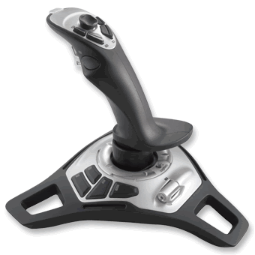
Continue…
Light Pen: A device that is used to move the pointer and select objects on the screen
Joysticks: an input device that consists of a stick on a base and used to control a device. Often used with video games

Slide 6
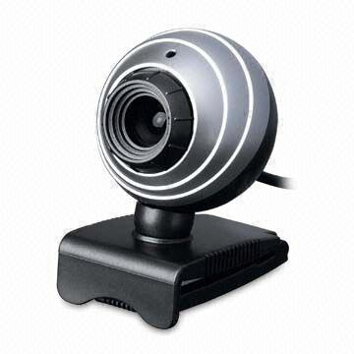
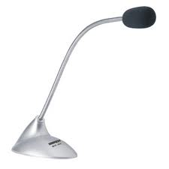
Continue…
Webcam: A video camera which feeds images to computer
Microphone: An input device that allows to send audio signals to computer for processing, recording, or running a command

Slide 7
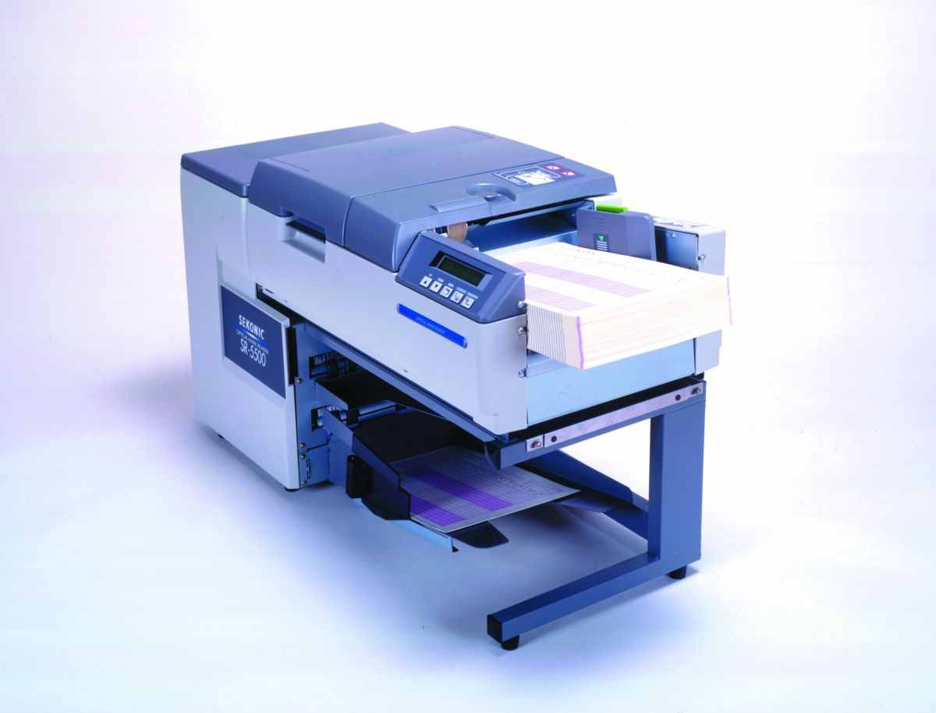
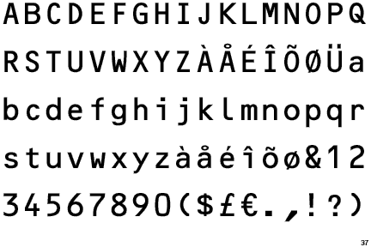
Continue…
OMR: It is an input device which is capable of recognizing a prescribed type of mark made by pencil or pen.
OCR: These devices are capable to read different shapes of mark and complete set of alphanumeric characters, also handwritten characters

Slide 8
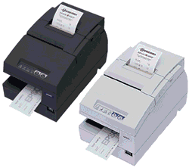
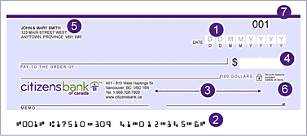
Continue…
MICR : Characters are printed using special ink which can be magnetized. Special ink are magnetized by write head and then the characters are read and decoded

Slide 9
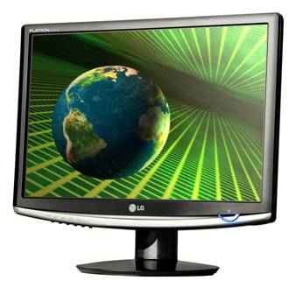
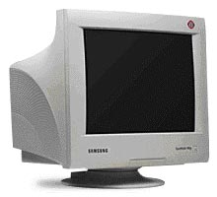
Output Devices
Output devices are used to output data from the computer to the external environment.
The following are some of the output devices:
  VDU (Visual Display Unit): the computer’s screen used to display data in a format that humans can understand

Slide 10
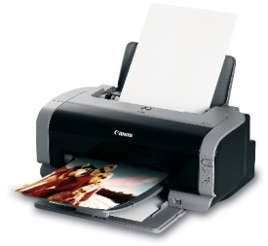
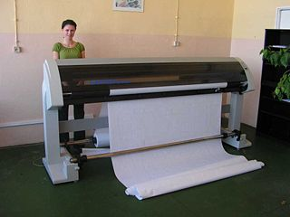
Continue…
Printer: A device that produces a hard copy of a file stored in an electronic form within the computer.
  -Many types of printers are available. Their use depends on their need
  -Large organizations use larger printers for better printing quality and higher printing speed
Plotter: a printing device that is used to print large images

Slide 11
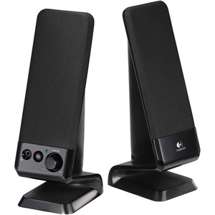

Continue…
Speakers: A device that converts electrical signals to sound
Multimedia Projector: Using a multimedia projector, you can show a DVD, video, slide show or television program on a large screen with color and sound.
-The images transmitted from the device are then transmitted into a special digitized light that is reflected on thousands of mirrors within the projector, which shines the image onto a screen.

Slide 12
CRT Display
Glass tube that is narrow at one end and opens to a flat screen at the other end.
Narrow end contains electron guns.
  Single gun for monochrome and three guns for color.
  The electron beam is directed towards the screen in the front of the tube using a high voltage.
  The screen is coated with a phosphor substance, which emits light when the electrons strike the substance.
  The color of the emitted light is the characteristics of the phosphor substance

Slide 13
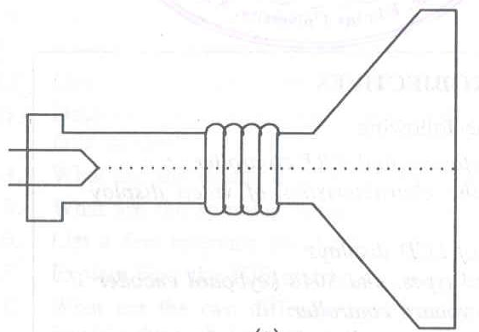
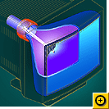
Continue…

Slide 14
Continue…
The electron beam is swept from left to right in the ‘X’ direction across the screen by applying a sweep voltage to the horizontal plates of the tube.
The beam is switched off when it reaches the right most end of the screen and is returned back to the left immediately.
Simultaneously, the beam is swept slowly in the Y direction from the top to the bottom of the screen by applying another swept voltage to the vertical plates of the tube.

Slide 15
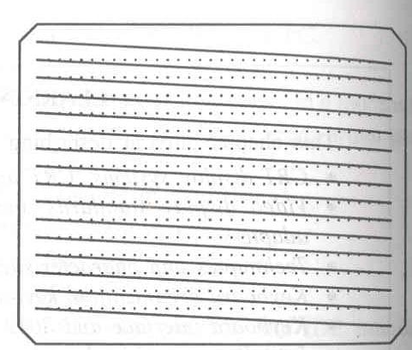
Continue…

Slide 16
Continue…
It makes the beam to trace a new line every time it scans from left to right.
The beam is switched off when it reaches the right bottom corner and returned back to the left top corner to start over.
A typical CRT display system sweeps the beam at the rate of 15,600 Hz in the horizontal direction and 60 Hz in the vertical direction. This is known as raster-scan.
The display system generates three signals to produce an image on the screen.
The signals are horizontal sweep signal, vertical sweep signal and video signal.

Slide 17
Advantages of CRT Display
Color: Most are capable of displaying unlimited colors.
Resolution: Multiple video Resolutions.
Response Time: Faster response time (25 milliseconds for LCD, 13 milliseconds for CRT)
Viewing Angle: Look @ a very wide angle

Slide 18
Disadvantages of CRT Display
Physical size: Takes more desktop space
Power Consumption and Radiation Emission
  Consumes more energy
  Emits harmful radiation. The metal shield behind the glass of your monitor protects your body from a flood of radiation.
  It holds a dangerous electrical charge even after turned off and can last up to several years and be hazardous and even deadly to anyone who opens a CRT monitor casing.
  Know to cause fires due to electrical malfunctions and excessive heat if the ventilation holes are accidentally covered up.

Slide 19
LCD Monitor
LCD screens are mostly used in portable systems
  where the screen image is generated on a flat plastic disk
  that uses millions of liquid crystal elements for the pixels
  and transistors for switching on and off the pixels
In 1997, manufactures began to offer full size LCD monitors as alternatives to CRT monitors

Slide 20
Advantages of LCD displays
The LCD monitor is slim and the screen is flat
Images on LCD screen seem to have a softer quality than images on CRT display.
Images on LCD screens do not flicker and do not cause strain to eyes.
LCD screens do not emit radiation
LCD screens have more visible area than CRT of same size.
LCD monitors consume significantly less power

Slide 21
Disadvantages of LCD displays
LCD monitors are expensive and limited in resolution.
LCD is not fast enough to display the fast changing images.
LCD screens are designed to operate in specific resolution
LCD technology requires bright back light to shine through the liquid crystal layer to create an image
Light that emerges from LCD is highly directional and it limits the viewing angles.

Slide 22
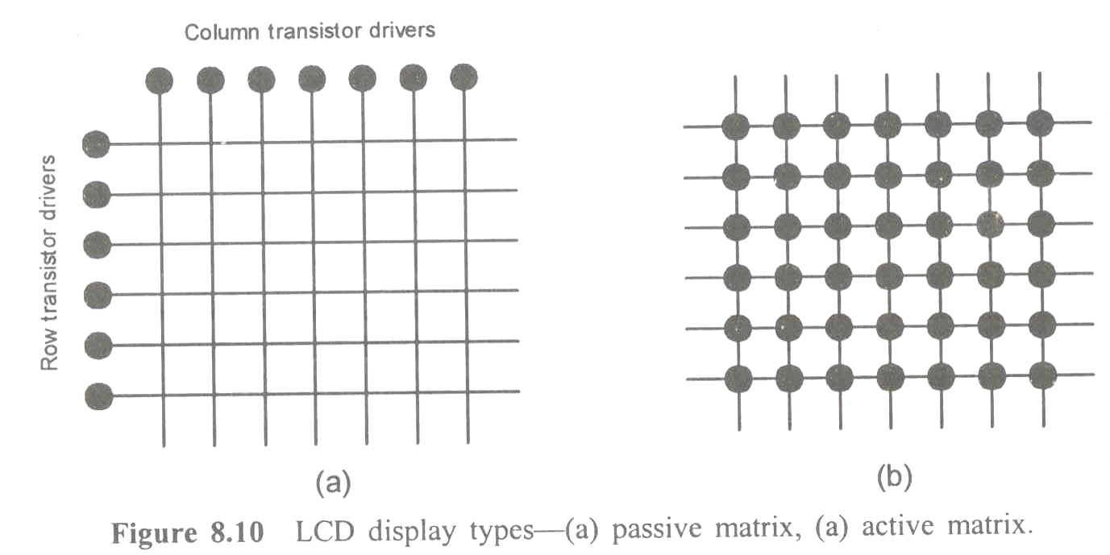
Types of LCD
LCD element form the pixels in LCD screen
The LCD elements are switched on and off by different techniques to display an image on the screen
There are two types of LCD screens:
- passive-matrix
- active-matrix

Slide 23
Passive Matrix LCD
Each LCD element in placed between two electrodes and arranged in rows and columns in X-Y matrix format.
The bottom electrodes of each row elements are connected together and the top electrodes of each column elements are connected together.
The elements in a row are controlled by a row-driver and the elements in a column by a column-driver.
Activating a row-driver and a column driver results in a current through a specific LCD element.

Slide 24
Active matrix LCD
AMLCDs use one transistor driver for each LCD element.
The transistors are arranged in the matrix format.
It allows the current through individual elements to be switched on and off quickly with sufficient current to get good contrast.
The electrodes for active matrix panels are also made of the transparent material.
The higher currents provide higher contrast and sharper and brighter images.

Slide 25
Printer
Printers are the primary output devices used to prepare permanent documents for human use.
Printing output is called hard copy output.
Three different types of printers are in use today. They are-
i) Dot-Matrix printer
ii) Ink-Jet printer and
iii) Laser-Jet printer

Slide 26
Dot-Matrix Printer
A dot matrix printer has a printer head, which contains an array of 7, 9, 14, 18 or 24 pins arranged in a vertical column.
While printing, the pins forming one column of dot pattern of the character matrix project from the print head and press the inked ribbon against a plain paper.
Only one column of dot pattern of character matrix is printed at a time.
As the print head moves across the line, series of vertical dot patterns representing the character are retrieved from the printer’s internal memory and printed

Slide 27
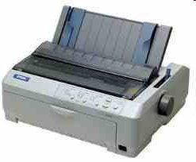
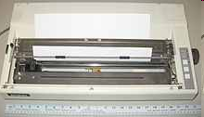

Continue….

Slide 28
Continue…
The print head is mounted on a carriage and moved back and forth along a rail by a belt.
The dot-matrix printers receive stream of character from the computer, convert to series of column of dot patterns and print.
The print quality depends on the number of pins provided on the print head.
24-pin printers produce high quality printouts

Slide 29
Ink-Jet Printer
The operation of the ink-jet printer is similar to that of a dot-matrix printer.
Ink-jet printers have tiny nozzles on the print head that spray ionized ink onto a plain paper in the pattern to form the characters and images.
The print head cartridge has 50 or more nozzles and is mounted on a carriage that is carried back and forth along a rail by a belt that is driven by a motor.
The print head is connected to the electronic control unit through a long, flat, flexible print head cable.

Slide 30
Continue…
When the PC sends a character to be printed, a series of vertical dot patterns representing the character is retrieved from the printer’s internal memory and sent through a series of print nozzle driver circuits.
The driver amplifies the signals into the fast, high-energy pulses needed to fire minute droplets of ink from each nozzle.
As the pulse reaches the nozzle, it creates an intense surge of heat that literally creates a bubble.
The nozzle cools down in a fraction of a second and becomes ready for another pulse.

Slide 31
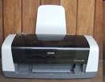
Continue…
The print quality of ink-jet printer depends on the quality of paper also.
They require periodic maintenance, as they use liquid ink.
The ink may dry in the nozzles and clog them

Slide 32
Laser-jet printer
Laser-jet printers function like a plain paper copier.
While a bright light source is used in a plain paper copier for generating the images, a laser is used in laser printer.
The laser printer creates an electrostatic image of a text or graphics page on a photosensitive drum using the laser beam.
When the drum is moved across the toner, it attracts the toner particles and deposits on the electrostatic image

Slide 33
Continue…
The drum is then pressed against a plain paper to transfer the image on to the paper.
The paper is then passed between hot rollers to fuse the toner particles into the paper.
The area of the drum is the same as that of the paper onto which the image is transferred.
Every point on the drum corresponds to a point on the paper
Laser printers are very popular today because of their print quality and relatively low running cost.
The print quality is less sensitive to paper quality

Slide 34
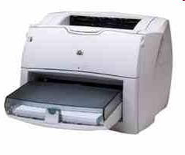
Continue…
Laser printers get all the information about the page to be printed and keep them in their internal memory before starting the printing.
The amount of memory present in a printer determines its capability

Slide 35
Thank You!

